Slide 1


如何修复关系
马太福音 18:15-20
Dr. Rick Griffith • 博士 • 新加坡神学院 • www.BibleStudyDownloads.org
10 December 2006
6 March 2011

Slide 2
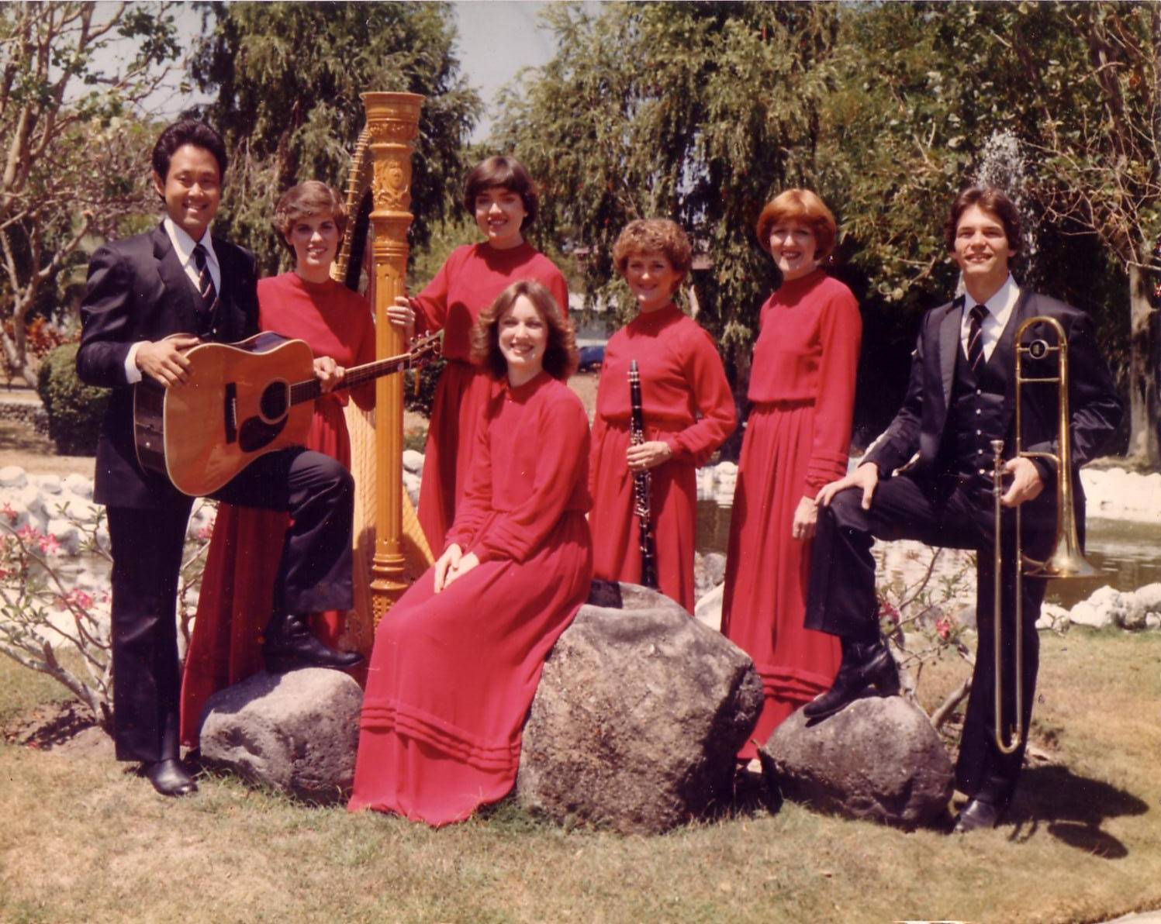
十字路团(1981-83)
Notes:
Some 30 years ago I sang on a music team of seven musicians called Crossroads. If you can’t tell, I am the guy who is not Japanese.

Slide 3
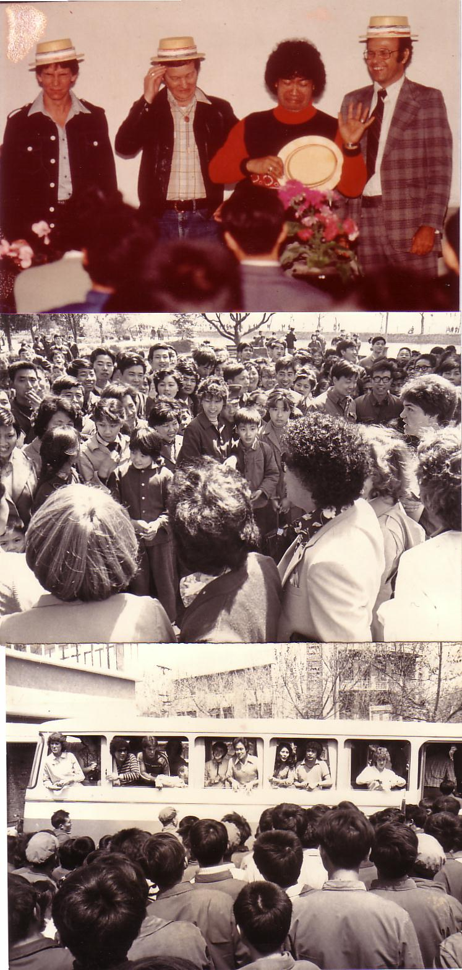
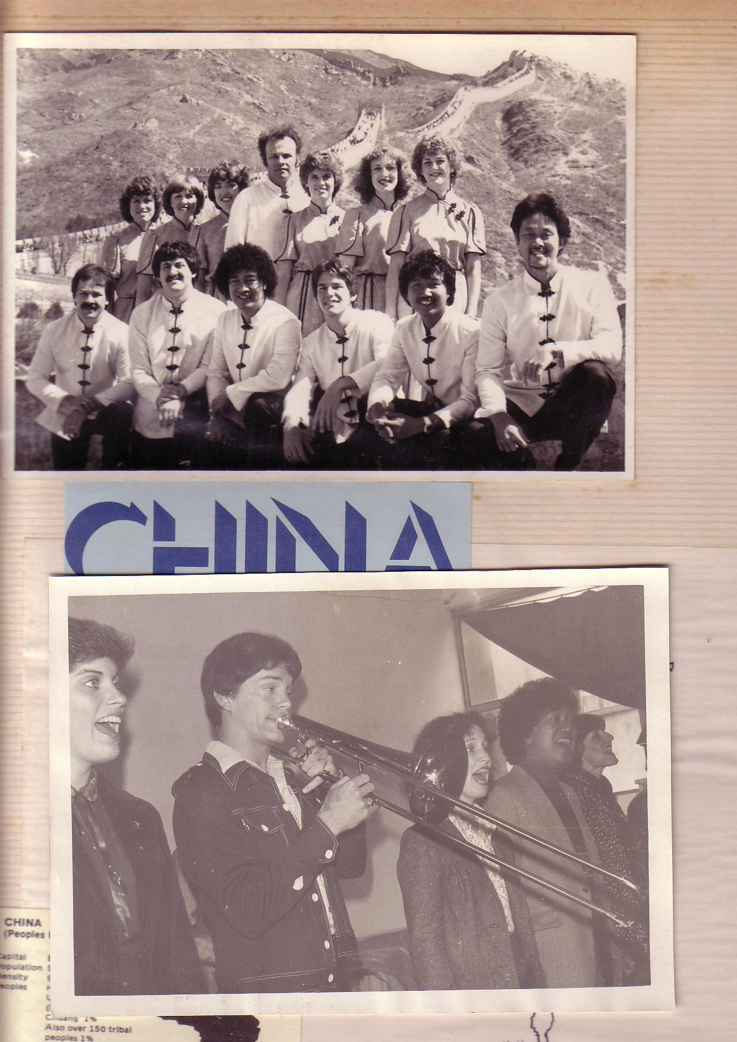
中国， 1981
Notes:
We shared the gospel in China and eleven other countries and—praise God—we reached over 600 people per concert!

Slide 4
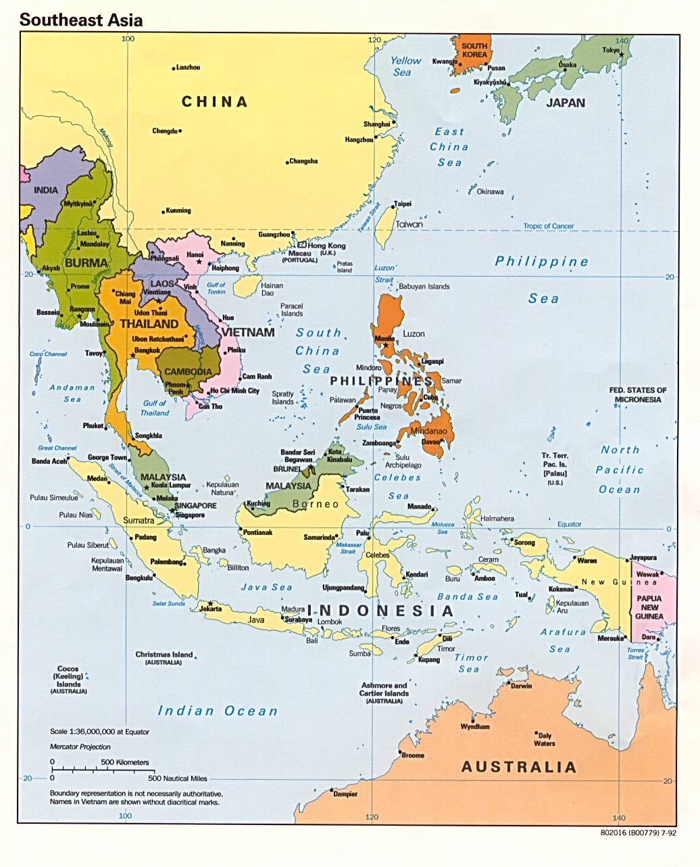
十字路事工
韩国
中国
日本
香港
台湾
澳门
泰国
菲利宾
马来西亚
新加坡
印度尼西亚
Notes:
The Crossroads team shared the gospel in 11 Asian nations and saw over 10,000 people indicate decisions to trust Christ! Again I was amazed at God's grace!

Slide 5
Black
Notes:
If you know anything about spiritual warfare, it is that the enemy of our souls concentrates his efforts on believers who are having an impact for Christ.
In our team, the opposition came from within—relationships that were a challenge. On that team was one particular woman named Kay. She was a godly woman but in terms of preferences, styles, and the like we didn’t see eye-to-eye at all. In fact, many times she felt that I just a "mister-know-it-all." (And of, course she was right as I did know it all.) She didn’t like my mannerisms, my clothes, or my insights in our group Bible studies. She avoided being around me and it seemed that I could do nothing right! She saw me as really arrogant.
So what do you do when you are forced into a working relationship with someone who just plain does not like you? I found that I couldn’t really avoid Kay. After all, every day we had four hours of music practice with the team. I had to sing in harmony with her—literally! But discord often reigned. Then we had a concert to give and had to work together.

Slide 6

Relational Pillars
信徒的
人际关系支柱
Notes:
God ministered to me then through two texts in Matthew that became "relational pillars" that I want to share with you today. These texts literally changed my life.

Slide 7
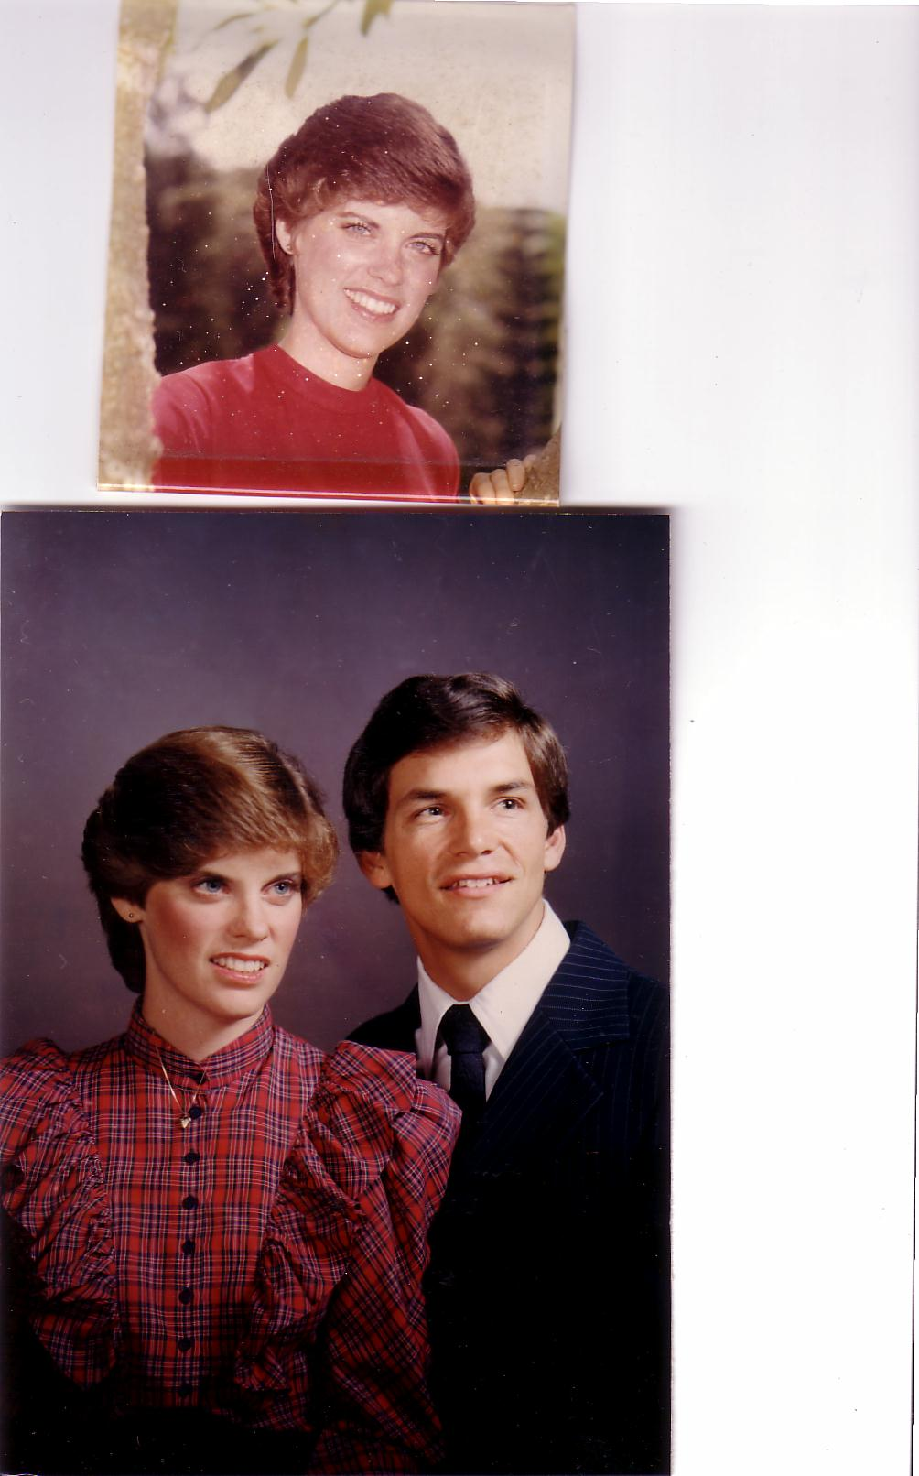
恋爱, 1982
Notes:
They enabled Kay and me to reconcile our differences—so much so that three years after our initial differences Kay actually said "yes" to marrying me!

Slide 8
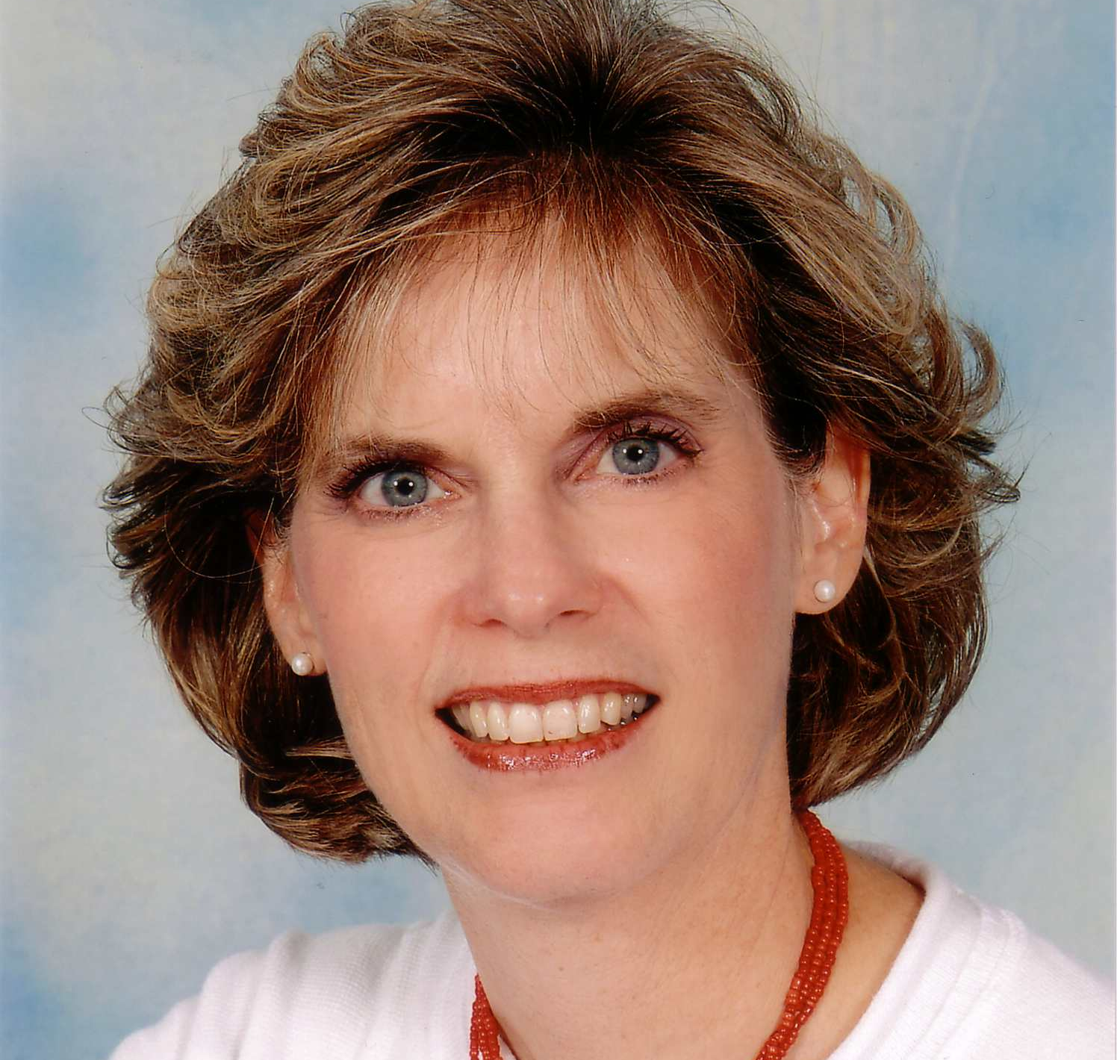
Susan Kay Griffith
Notes:
Yes, Kay is her middle name. Her full name is now Susan Kay Griffith.

Slide 9

Matthew's Relational Pillars
马太福音的人际关系支柱
5:23-24
你是:
冒犯别人者
问题:
一般情况
Notes:
Have you ever had a problem with another believer? (If you say “no,” then I wonder which planet you have been living on!) Are you in fellowship with every Christian that you know now—your family members, your work colleagues, your neighbors and friends? If you’re not in harmony, what should you do?

Slide 10
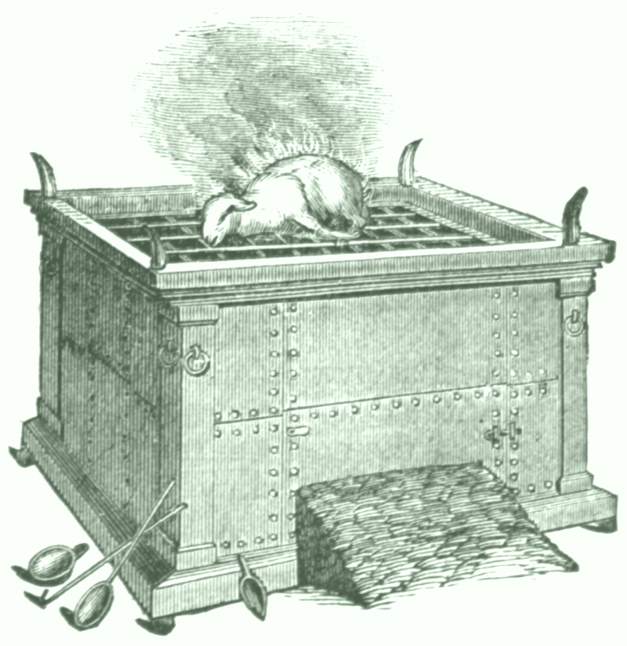

马太福音 5:23-24
Notes:
If you hurt the other person, Matthew 5 tells you what to do.
Let’s read it.
God places the responsibility to reconcile on you if you are the offender.

Slide 11
马太福音 5:23-24
"所以你在祭坛上献礼物的时候，若想起弟兄向你怀怨，就把礼物留在坛前，先去同弟兄和好，然后来献礼物。"
?
Notes:
The last I checked, believers weren’t offering up sacrifices at the altar. So what does the "altar" refer to today?

Slide 12
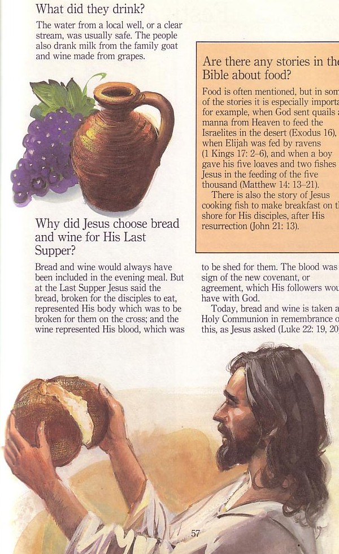
主餐
Notes:
At the very least, it refers to the Lord’s table—a sign of our fellowship & unity.

Slide 13
Matthew's Relational Pillars
马太福音的人际关系支柱
5:23-24
18:15-17
你是:
冒犯别人者
被冒犯者
问题:
一般情况
罪
Notes:
However, in some situations, you are the offended. The other person is guilty of sin. Every church eventually encounters problems with believers living in sin. In these cases a loving body will restore them to God’s holiness.

Slide 14



如何正确地挽回犯罪的基督徒?
我们今天第一个问题 (15-17节)
Notes:
So how do we restore sinning Christians properly? (This issue is addressed in your sermon outline.) When someone goes astray from God’s will, what process do we use to bring that person back?

Slide 15
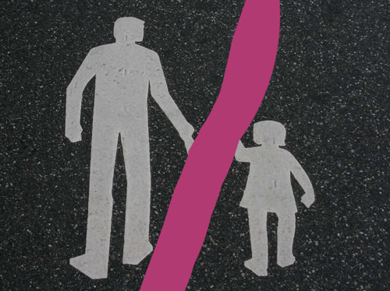



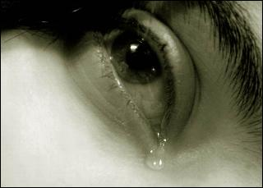
其他关系
Notes:
This doesn’t just refer to marriage, nor to serious sins—it's any kind of sin that can hurt any relationship among believers.

Slide 16
Black
Notes:
Why I am talking about resolving relational problems now?
I just know that issues surface in every relationship, including ours. At some point, I am going to offend you and you will offend me. So what should we do?

Slide 17
马太福音第18节
的价值
1
一
一个
小孩
(1-9)
一只
羊
(10-14)
一个
罪人
(15-20)
一个
欠债者
(21-35)
Notes:
So our key text today is Matthew 18. The context of Matthew 18 is the value of one—
• one child (1-9), one sheep (10-14), one sinner (15-20), one debtor (21-35).
• At the heart of this chapter is verses 15-20…

Slide 18
马太福音18:15-20
所以你在祭坛上献礼物的时候，若想起弟兄向你怀怨，就把礼物留在坛前，先去同弟兄和好，然后来献礼物。 倘若你的弟兄得罪你，你就去趁着只有他和你在一处的时候，指出他的错来。他若听你，你便得了你的弟兄。他若不听，你就另外带一两个人同去，要凭两三个人的口作见证，句句都可定准。若是不听他们，就告诉教会。若是不听教会，就看他像外邦人和税吏一样。我实在告诉你们，凡你们在地上所捆绑的，在天上也要捆绑。凡你们在地上所释放的，在天上也要释放。我又告诉你们，若是你们中间有两个人在地上，同心合意地求什么事，我在天上的父，必为他们成全。因为无论在哪里，有两三个人奉我的名聚会，那里就有我在他们中间。
如何挽回
15-17
为何挽回
18-20
Notes:
In Matthew 18:15-20 Jesus provides God’s plan for loving church discipline. Let’s read it together [read 15-20.] This text has two main teachings on restoring Christians in sin.
• Verses 15-17 give how to restore them and…
• Verses 18-20 give why to restore them.
Let’s first see how to restore relationships. God’s way to restore believers in sin is to…

Slide 19

The Point of Verses 15-17
1. 尽量在
私底下
进行
(15-17)
Notes:
God’s strategy to bring sinning Christians back is to involve as few people as you can.

Slide 20
我们的目标：
挽回！
Notes:
The desired end is restoration, not punishment or excommunication.
The goal of discipline is behavior change to bring the wayward one back. Unfortunately, too many churches "excommunicate" to punish rather than restore).
Restoration is God’s goal for a wandering saint in the sheep image of verses 10-14.
Restoration is the explicit teaching of this text in verse 15b.
Restoration is the goal of church discipline in other passages like Galatians 6:1.

Slide 21


Restore People in Sin
挽回犯罪的人
"弟兄们，若有人偶然被过犯所胜，你们属灵的人，就当用温柔的心，把他挽回过来。又当自己小心， 恐怕也被引诱。" (加 6:1）

Slide 22
神挽回的
四个步骤：
4
3
2
1
…逐步向更多人透露
Notes:
God’s restoring process has four steps that progressively tell more and more people about the sin (15-17).

Slide 23

挽回的第一步：
你亲自向他说
M
M
M
M
M
M
M
M
M
M
M
M
M
M
M
M
S
M
M
M
M
M
M
M
M
M
M
M
S = Sinner 犯罪的人
M = Member 会友
Notes:
What’s our human tendency here?
• It is to tell others about the problem instead of the one involved.
• God commands us to keep the issue as private as possible.

Slide 24
Matthew's Relational Pillars
马太福音的人际关系支柱
5:23-24
18:15-17
你是:
冒犯别人者
被冒犯者
问题:
一般情况
罪
Notes:
This differs from Matthew 5 in that you’re not an offender, but the offended.
• Note also that in Matthew 5 sin may not be in the picture, but Matthew 18 deals specifically with a believer living in sin. This does not refer simply to differences of opinion on debatable matters.

Slide 25
Matthew's Relational Pillars
马太福音的人际关系支柱
5:23-24
18:15-17
你是:
冒犯别人者
被冒犯者
问题:
一般情况
罪
主动者:
你！
你!
Notes:
Earlier we saw from Matthew 5:23-24 that God places the responsibility to reconcile on you if you are the offender. Now whose job is it to initiate if you are the offended?
• Yes, again it is your responsibility again! You say, "That’s not fair! Why is it my job in both situations? Whether I am the offender or the offended I still have to make the first move?" Well, if relationships are not resolved between believers, it has to be through the fault of both—as both have the command of God to resolve it!

Slide 26
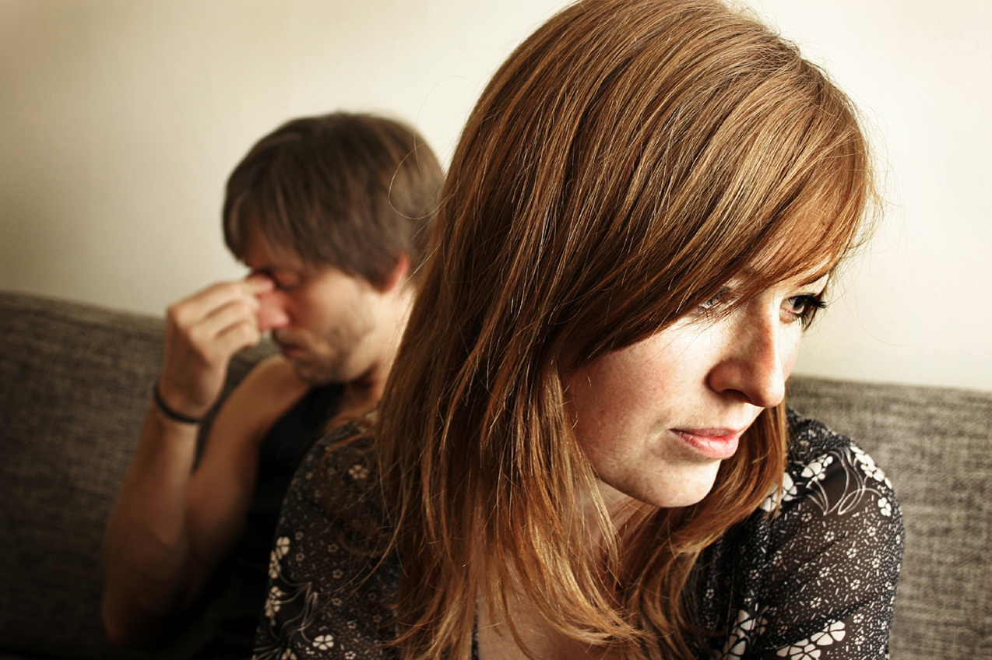
亲自去
不是:
电邮
短信
书信
电话
Notes:
While letter writing was very popular in the time of Christ, our Lord specifically says to deal with these sensitive matters face-to-face. Today this means confrontation should never be handled via email, SMS, letter, or phone calls. It also prohibits the cowardice of anonymous communication.

Slide 27
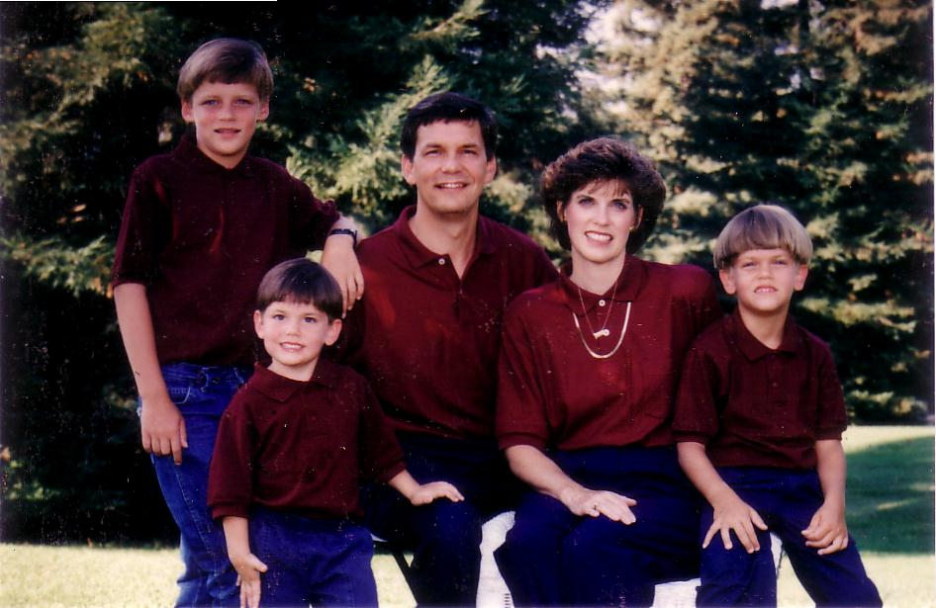
1996
Notes:
Our family has tried to do this since our three sons were young—not to let them do the "Mom! Dad! So-and-so did such-and-such to me!" We just told him, "Matthew 18, bud. If you can’t solve it, we’ll be step 2…" They rarely came back to us!

Slide 28
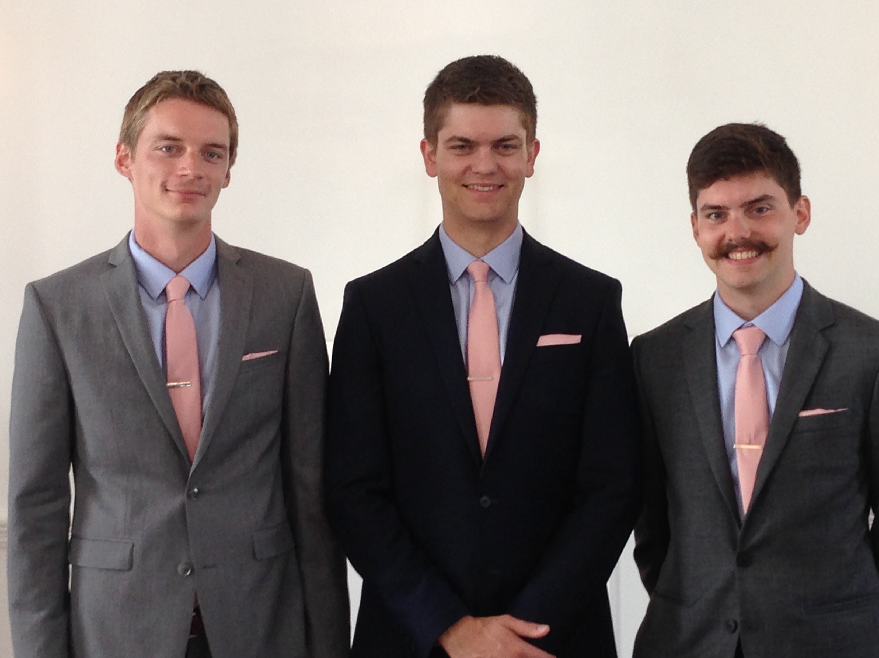
兄弟们…
Notes:
Now that they are older, they solve the problems among themselves without our intervention. Some friends were amazed that Kurt and Stephen moved to the US for college and decided to stay as roommates—for 7 years until they married!

Slide 29

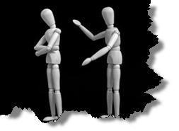
为何不面对面交锋?
无知
怀疑
失败
害怕
藉口
不纯
缺乏交际
Notes:
However, most of the time believers don’t keep issues private—or we don’t address them at all. Why do you think don’t we confront others? Tell the person next to you why! (Small groups for 1 min.) Why not?
• ignorance of what God commands here?
• doubt that it will work?
• failure of past confrontations that didn’t work?
• fear that we might look bad?
• excuses that we can’t get together?
• impurity in our own life?
• unsocial in that we just don’t care enough to risk it?

Slide 30
挽回的第一步：
你亲自向他说
M
M
M
M
M
M
M
M
M
M
M
M
M
M
M
M
S
M
M
M
M
M
M
M
M
M
M
M
S = Sinner 犯罪的人
M = Member 会友
Notes:
So… you should talk to the person by yourself—even though our tendency is to tell others instead. But what if the offender does not repent? We need step 2 where we…

Slide 31
挽回的第二步：
带一两个人同去
M
M
M
M
M
M
M
M
M
M
M
M
M
M
M
M
S
M
M
M
M
M
M
M
M
M
M
M
S = Sinner 犯罪的人
M = Member 会友
Notes:
Take one or two others along (16).

Slide 32

第二步骤的问题
应该带谁去？
为什么一两个人？
Notes:
Who should these 1-2 others be? These persons should be individuals whom the offender respects as they will best help restore him/her. They should not go instead of the offended believer, but along with this person.
• Why take 1-2 others along?

Slide 33
申命记 19:15
人无论犯什么罪，作什么恶，不可凭一个人的口作见证，总要凭两三个人的口作见证才可定案 。
Notes:
The OT law prohibited conviction of crimes based on only one person’s testimony (read Deut. 19:15). The NT teaching is the same, protecting the offender from an easily offended or lying accuser.
What if the offender still does not repent? Go to step 3…

Slide 34
挽回的第三步：
告知教会全体
M
M
M
M
M
M
M
M
M
M
M
M
M
M
M
M
S
M
M
M
M
M
M
M
M
M
M
M
S = Sinner 犯罪的人
M = Member 会友
Notes:
The church leadership certainly must be involved at this point before the matter is brought to the congregation. They also must see the issue isn’t just a difference of opinion between two parties; the biblical basis for the offender living in sin must be clearly shown with specific passages.

Slide 35
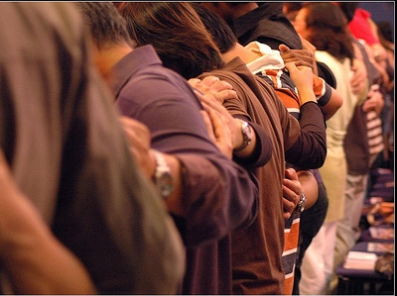
为什么要告知教会全体？
Notes:
Bringing the matter to the entire church is vital, since without it the sinning person will be able to find fellowship in other smaller groups within the larger church who do not know of his/her sin. Such gossip situations inevitably bring disunity, which lead to factions that can split the body.
What, then, should the entire church do once discipline has been determined? Step 4…

Slide 36
挽回的第四步：
看他作外邦人
M
M
M
M
M
M
M
M
M
M
M
M
M
M
M
M
S
M
M
M
M
M
M
M
M
M
M
M
S = Sinner 犯罪的人
M = Member 会友
S

Slide 37

Sins Worthy of Discipline
管教却不可
逐出教会！
Notes:
Sometimes this step has been misinterpreted to mean "excommunication" where the errant person is never contacted again.

Slide 38

Sins Worthy of Discipline
如何执行管教
不要称他/她作基督徒
向他/她传福音
不要让他/她领圣餐
取消他/她的教会会籍
不让他/她在教会里事奉
非信徒
要把犯淫乱的人"交给撒但 "（林前5:5）
不可与他/她吃饭（林前5:11）
禁止他/她参加教会？
更差
Notes:
But Jesus said to "treat him as you would a pagan or a tax collector." Jesus treated pagans with love and kindness, but he didn’t ask them to evangelize the lost as part of his team. You shouldn’t be ugly or ungodly, but…
• Don’t refer to him/her as a Christian. (ILL: I have done this with my former brother-in-law who divorced my sister to marry another woman.)
• Evangelize this person.
• Don’t let him/her take the Lord’s Supper.
• Remove the person from membership.
• Remove this person from church roles (ILL: My friend Paula was asked to leave her church kitchen ministry once her adultery was discovered.)
But in other ways it is more serious than how we treat unbelievers:
• "Deliver over to Satan" one in sex sin (1 Cor. 5:5). Years ago a friend named John left his wife and two small boys for another woman. My church disciplined him, but an elder kept up with him to restore him. After five years, he showed up at church—but he looked 20 years older!
• Don’t eat with him/her (1 Cor. 5:11).
• Should we prohibit the person from attending church? Some say they, like unbelievers, should be welcomed in services without taking the Lord’s Supper; but in most discipline cases this is not even an issue as few disciplined believers seek to return to the assembly until repentant.

Slide 39
The Point of Verses 15-17
1. 尽量在
私底下
进行
(15-17)
Notes:
So that’s God’s 4-step process—to keep the matter as private as possible.

Slide 40
神挽回的
四个步骤：
4
3
2
1
…逐步向更多人透露
Notes:
This is the intent in each of the four steps with the goal of restoration.

Slide 41

第二个问题的答案在第18-20节：
为何要正确地挽回犯罪跌倒的基督徒？
Notes:
But why must we do all this? What right do we have to discipline our members? Why must we restore sinning Christians properly? Because…

Slide 42

第18-20节的重点：
II.教会的行动
是神权柄的延伸！
Notes:
God’s right to judge is actually delegated to us!

Slide 43

为何要执行处分?
当我们尝试挽回…
我们代父
执行
(18-19)
Notes:
We act in the place of the Father when we seek to restore someone (18-19).

Slide 44
A Better Translation…
NAU 是更好的翻译
NIV "我实在告诉你，你们在地上捆绑的，在天上也将被捆绑
你们在地上释放的，在天上也被或已经被释放。"
NAU “我实在告诉你，你们在地上捆绑的，在天上已经被捆绑；你们在地上释放的，在天上已经被释放。
Notes:
新国际版和新美国标准版
Too often today’s churches act as if they have no authority under God, and yet "binding" here refers to disciplining (a guilty verdict) while "loosing" refers to releasing from discipline (an innocent verdict).

Slide 45

马太18:19
"我又告诉你们，若是你们中间有两个人在地上，同心合意地求什么事，我在天上的父，必为他们成全。 "
（和合本）
Notes:
We should trust that our prayerful judgments are God’s will.

Slide 46
诗篇 82:1,6
(给以色列的统治者／神明)
"我曾说过："你们都是神，是至高者的儿子。… 但你却仍然像人一样死亡…"
Notes:
Ps. 82:6 has a similar idea where Israel’s rulers are called "gods" in that they rule others.
Why should we trust this process in discipline situations? Verse 20 says that…
08.41

Slide 47
为何要执行处分?
当我们尝试挽回…
我们代父
执行
(18-19)
我们在基督
面前并以他的权柄执行
(20)
Notes:
When we seek to restore someone, we act in the presence and authority of Christ (20).

Slide 48
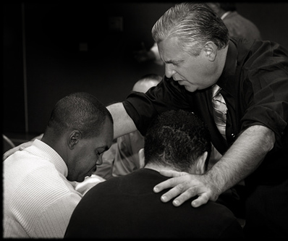
太18:20
"因为无论在哪里，有两三个人奉我的名聚会，那里就有我在他们中间 。"
（和合本）
Notes:
The "two or three" refers to the witnesses whose testimony enacted discipline (v. 16).
The point of Christ being "in their midst" is that local church discipline acts with the presence and authority of Christ Himself.

Slide 49
我们为何要合宜地挽回犯了罪的基督徒呢？
Notes:
So how can we sum up this passage in one sentence? I’d say it this way…

Slide 50

中心意思:
我们必须正确地挽回犯罪的会友因为我们代表上帝行动
Notes:
When sheep stray, we shepherd them back as loving hands of God’s grace.

Slide 51
Matthew's Relational Pillars
马太福音人际关系支柱
5:23-24
18:15-17
你是:
冒犯别人者
被冒犯者
问题:
一般情况
罪
主动者:
你!
你!
Notes:
God expects each of us to take the initiative—

Slide 52
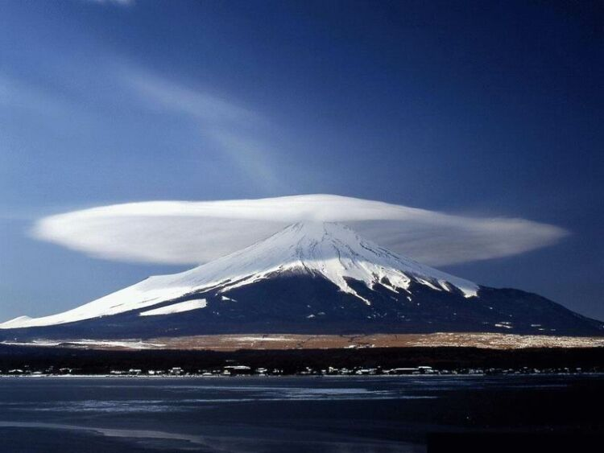
总原则
"可能的话，总要尽你们的所能与人和睦"
罗马书 12:18
Notes:
—and to do so as far as possible, as Romans 12:18 says [read]. This verse is a great encouragement to do all we can even if others are not responsive.

Slide 53
Matthew's Relational Pillars
马太福音的人际关系支柱
5:23-24
18:15-17
总原则: 罗马书 12:18
你是:
冒犯别人者
被冒犯者
问题:
一般情况
罪
主动者:
你！
你!
Notes:
This verse is a great overall principle in relationships.

Slide 54

Make us one 3/3
主啊 让我们合而为一
让我们合而为一
圣灵啊 让我们合而为一
愿你爱涌流
让世界知道
我们在你的里面合而为一
Notes:
God desires us to truly live out the chorus "Make Us One, Lord"

Slide 55
上帝在对你说什么？
a. 教会肢体
M
M
M
M
M
M
M
M
M
M
M
M
b. 你自己的生活
M
M
M
M
S
M
M
M
M
M
M
M
M
c. 帮助他人
M
M
M
Notes:
Matthew 18 relates to us in at least three ways:
• To be in this assembly you must submit to its authority under God. This means that we will lovingly seek to restore you should you fall.
• Is there sin in you worthy of discipline? Clean it up now to avoid pain for us all!
• Do you know anyone who needs a private confrontation? Romans 12:18 encourages you to do everything possible to be at peace with all people, so do it!

Slide 56


新约全书讲章 • BibleStudyDownloads.org
免费获得该讲解!
圣经学习下载
Notes:
If you want this message PPT and text, just download it at BibleStudyDownloads.org at the NT Preaching link.

Slide 57
Black

